Slide 1
Lecture 17
Software Design Pattern
BSCS (Software Engineering-I) SZABIST-Islamabad

Slide 2
Software Design Pattern
Definitions
“A solution to a problem in a context”
“Each pattern describes a problem which occurs over and over again in our environment and then describes the core of the solution to that problem, in such a way that you can use this solution a million times over, without ever doing it the same way twice.”
BSCS (Software Engineering-I) SZABIST-Islamabad

Slide 3
Components for Pattern
Name
Purpose, the problem it solves
Way to accomplish this
Constraints and forces we have to consider in order to accomplish it
BSCS (Software Engineering-I) SZABIST-Islamabad

Slide 4
Why study design patterns?
Because design patterns-
Help reuse existing high quality solutions to commonly occurring problems
Improve individual and team learning
Shift level of thinking to a high perspective
Illustrate basic object-oriented principles
Improves modifiability and maintainability of the code
Improve team communication n individual learning
BSCS (Software Engineering-I) SZABIST-Islamabad

Slide 5
Types of patterns
Structural
  Façade
  Adapter
  Bridge
  Composite
  Decorator
  Flyweight
  Proxy
Behavioral
  Observer
  Chain of Responsibility
  Command
  Interpreter
  Mediator
  Memento
  State
  Strategy
  Template Method
  Visitor
Creational
  Singleton
  Abstract Factory
  Builder
  Factory Methods
  Prototype
BSCS (Software Engineering-I) SZABIST-Islamabad

Slide 6
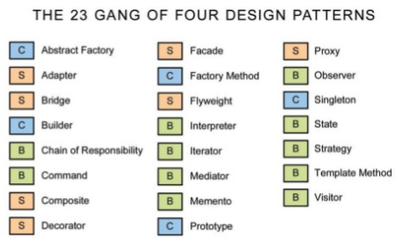
Examples
BSCS (Software Engineering-I) SZABIST-Islamabad

Slide 7
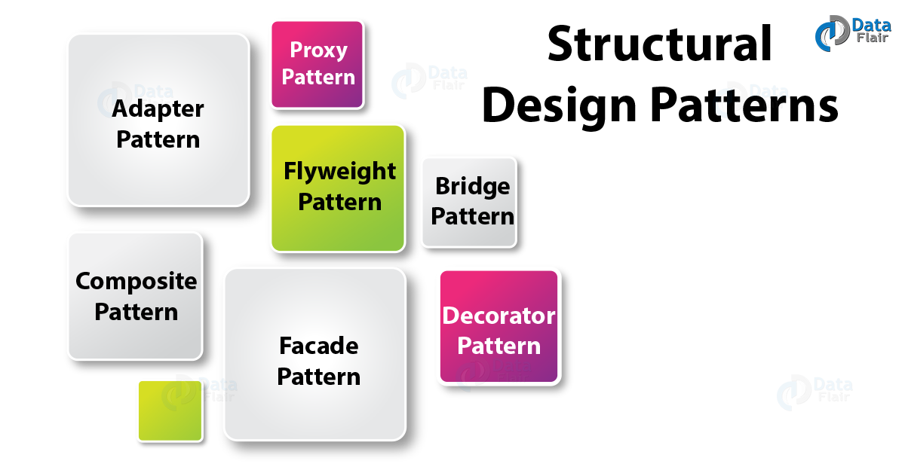
Structural Design Patterns in Java
Structural Patterns are concerned about providing solutions and efficient standards regarding class compositions and object structures. Also, they rely on the concept of inheritance and interfaces to allow multiple objects or classes to work together and form a single working whole.
BSCS (Software Engineering-I) SZABIST-Islamabad

Slide 8
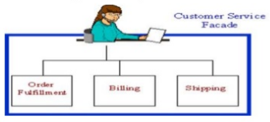
1) Façade Pattern
Provide a unified interface to a set of interfaces in a subsystem.
Defines a higher-level interface that makes the subsystem easier to use.
Non-software example for façade
The customer service representative acts as a Facade, providing an interface to the order fulfillment department, the billing department, and the shipping department. Object Diagram for facade using Phone Order
Software example
In temple run game the “upgrade” option acts as a façade, giving an interface for selecting a player, for abilities and power up.
BSCS (Software Engineering-I) SZABIST-Islamabad

Slide 9
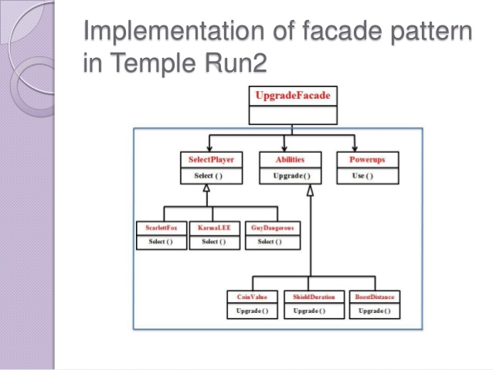
Implementation of Façade Pattern in Temple Run2
BSCS (Software Engineering-I) SZABIST-Islamabad

Slide 10
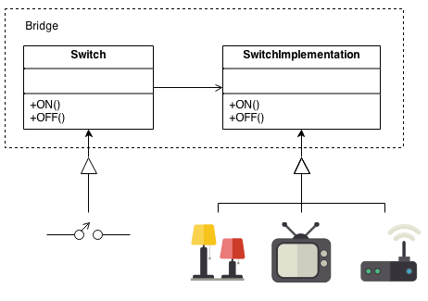
2) Bridge Pattern
The Bridge pattern decouples an abstraction from its implementation, so that the two can vary independently.
Non-Software Example:
A household switch controlling lights, ceiling fans, etc. is an example of the Bridge.
The purpose of the switch is to turn a device on or off.
The actual switch can be implemented as a pull chain, a simple two position switch, or a variety of dimmer switches.
BSCS (Software Engineering-I) SZABIST-Islamabad

Slide 11
Bridge Pattern
Software example
In temple run game we can have following options under the caption “play”
  Swipe
  Slide
  Tilt
  Duck
  Double tap
Using bridge pattern we are switching between one of the above operation without even knowing the actual implementation.
BSCS (Software Engineering-I) SZABIST-Islamabad

Slide 12
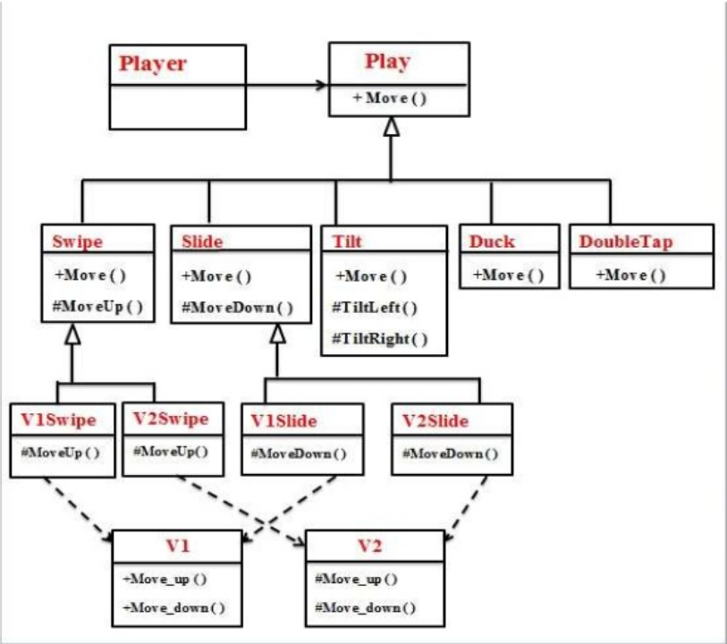
Implementation of Bridge Pattern in Temple Run2
BSCS (Software Engineering-I) SZABIST-Islamabad

Slide 13
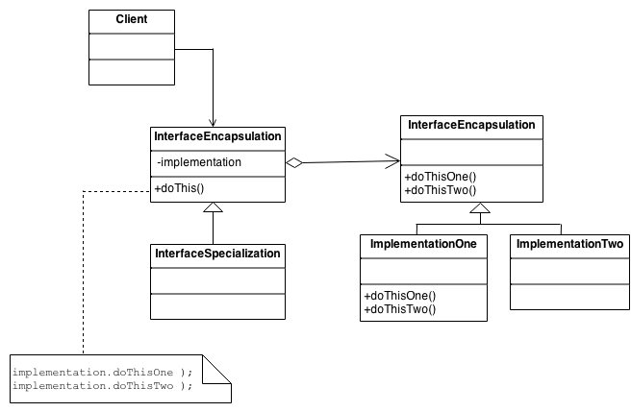
Implementation of Bridge Pattern Java
The Client doesn't want to deal with platform-dependent details. The Bridge pattern encapsulates this complexity behind an abstraction "wrapper".
Bridge emphasizes identifying and decoupling "interface" abstraction from "implementation" abstraction.
BSCS (Software Engineering-I) SZABIST-Islamabad

Slide 14
3) Decorator Pattern
Attach additional responsibilities to an object dynamically keeping the same interface.
Decorators provide a flexible alternative to sub classing for extending functionality.
The object that we want to use does the basic function.
However, we need to add some additional functionality occurring before or after the object’s base function.
Allows extension of functionalities without resorting sub classing.
BSCS (Software Engineering-I) SZABIST-Islamabad

Slide 15
Decorator Pattern
Non-software example:
The Decorator attaches additional responsibilities to an object dynamically.
Although paintings can be hung on a wall with or without frames, frames are often added, and it is the frame which is actually hung on the wall.
Prior to hanging, the paintings may be matted and framed, with the painting, matting, and frame forming a single visual component.
BSCS (Software Engineering-I) SZABIST-Islamabad

Slide 16
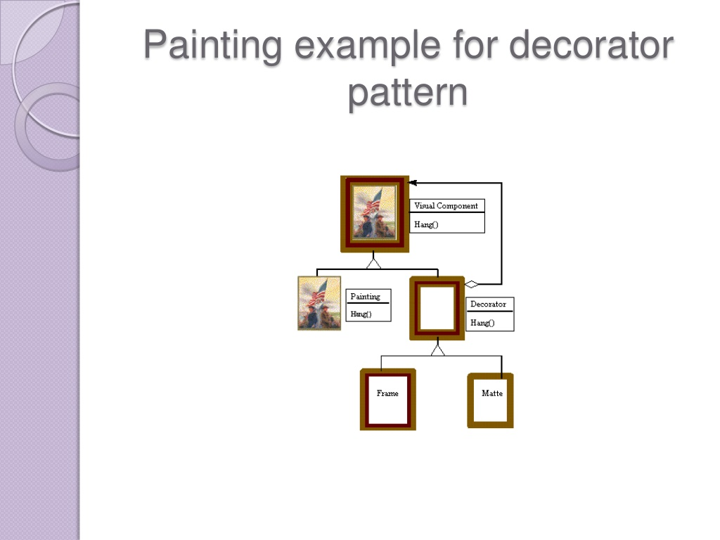
Painting example for decorator pattern
BSCS (Software Engineering-I) SZABIST-Islamabad

Slide 17
Decorator Pattern
Software example
In temple run game, run is a basic object. The player can simply go on running without taking any power ups(boost, shield, coin magnet).
Additional functionality like Boost(runs faster), shield(protects from fire n other obstacles), coin magnet(attracts the coins automatically while running) will be added if the player takes any of the above mentioned power ups which will be appearing on the screen while running.
BSCS (Software Engineering-I) SZABIST-Islamabad

Slide 18
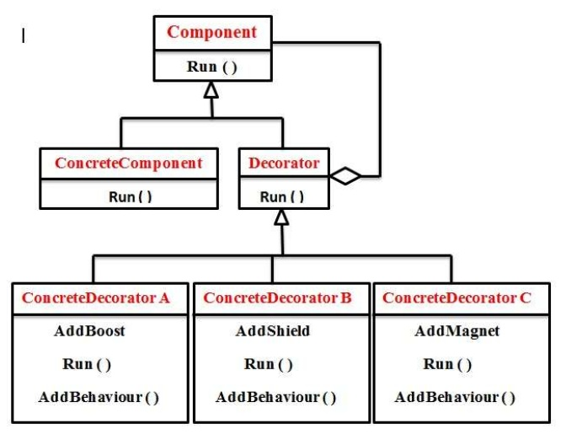
Implementation of Decorator Pattern in Temple Run2
BSCS (Software Engineering-I) SZABIST-Islamabad

Slide 19
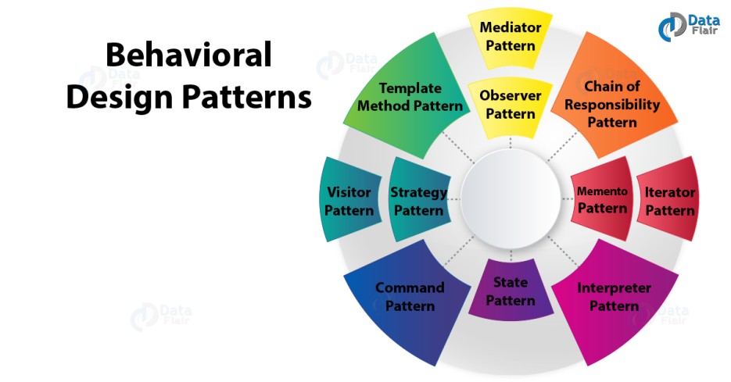
Behavioral Design Patterns in Java
Behavioral Patterns Behavioral Java patterns give an answer for the higher interaction between objects and the way to produce lose coupling and adaptability to increase simply.
Behavioral design patterns identify common communication patterns between objects and realize these patterns. By doing so, these patterns increase flexibility in carrying out this communication.
BSCS (Software Engineering-I) SZABIST-Islamabad

Slide 20
1) Observer Pattern
Define a one-to-many dependency between objects where a state change in one object results in all its dependents being notified and updated automatically.
Observers delegate the responsibility for monitoring for an event to a central object(the subject) so that it can notify a varying list of objects that an event has occurred.
BSCS (Software Engineering-I) SZABIST-Islamabad

Slide 21
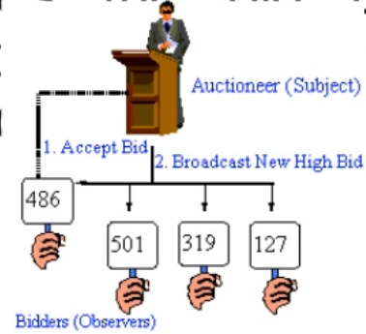
Observer Pattern
Non-software example
The following figure shows an Auction example of an observer
The auctioneer starts the bidding, and "observes" when a paddle is raised to accept the bid. The acceptance of the bid changes the bid price, which is broadcast to all of the bidders in the form of a new bid.
BSCS (Software Engineering-I) SZABIST-Islamabad

Slide 22
Observer Pattern
Software example
In temple run game, when the player completes certain objective(s) following needs to be updated/ notified automatically-
  Current list (list of objectives to be achieved)
  Complete list (list of objectives completed)
  Increase multiplier
  Increase score
BSCS (Software Engineering-I) SZABIST-Islamabad

Slide 23
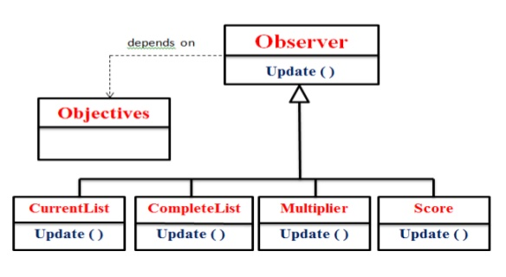
Implementation of Observer Pattern in Temple Run2
BSCS (Software Engineering-I) SZABIST-Islamabad

Slide 24
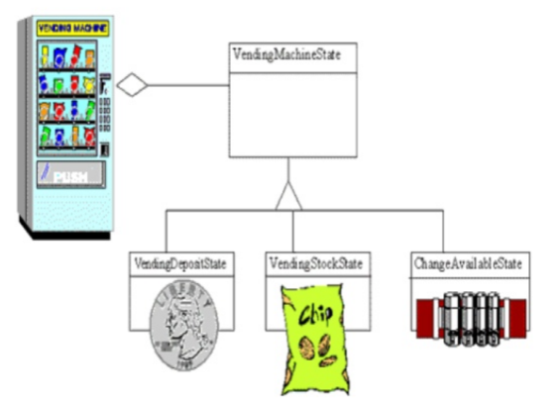
2) State Pattern
Allow an object to alter its behavior when its internal state changes.
The object will appear to change its class.
Non-software example
This pattern can be observed in a vending machine.
Vending machines have states based on the inventory, amount of currency deposited, the ability to make change, the item selected, etc.
When currency is deposited and a selection is made, a vending machine will either deliver a product and no change, deliver a product and change, deliver no product due to insufficient currency on deposit, or deliver no
BSCS (Software Engineering-I) SZABIST-Islamabad

Slide 25
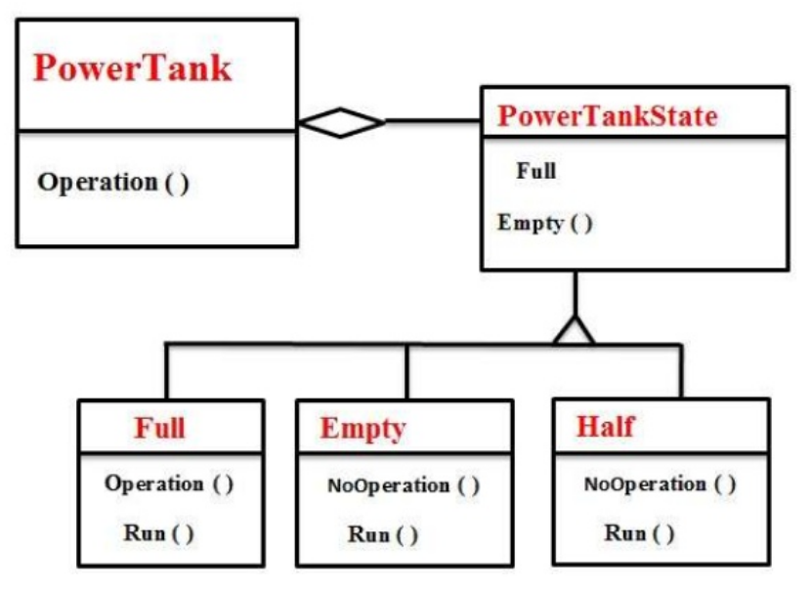
Implementation of state pattern in Temple Run2
BSCS (Software Engineering-I) SZABIST-Islamabad

Slide 26
3) Template Pattern
The Template Method defines a skeleton of an algorithm in an operation, and defers some steps to subclasses.
Template method lets subclasses redefine certain steps of an algorithm without changing the algorithms structure
Allow definition of subsets that vary while maintaining a consistent basic process
BSCS (Software Engineering-I) SZABIST-Islamabad

Slide 27
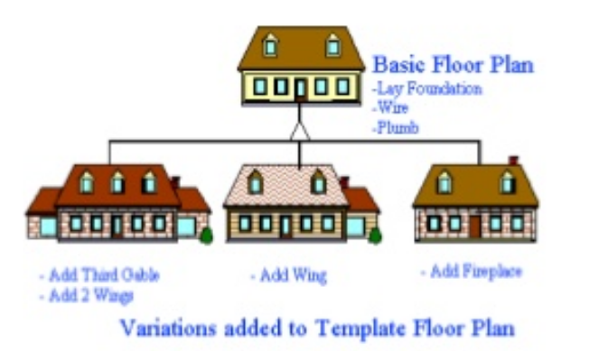
Template Pattern
Non-software example
Home builders use the Template Method when developing a new subdivision.
A typical subdivision consists of a limited number of floor plans, with different variations available for each floor plan.
Within a floor plan, the foundation, framing, plumbing, and wiring will be identical for each house.
Variation is introduced in the latter stages of construction to produce a wider variety of models.
BSCS (Software Engineering-I) SZABIST-Islamabad

Slide 28
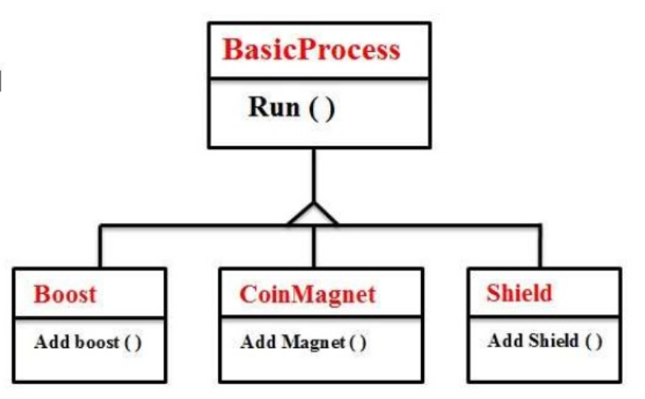
Template Pattern
Software example
In temple run game the basic process is running.
Variations can be introduced when the player takes boost, coin magnet or shield while running which will not affect the basic process i.e running.
BSCS (Software Engineering-I) SZABIST-Islamabad

Slide 29
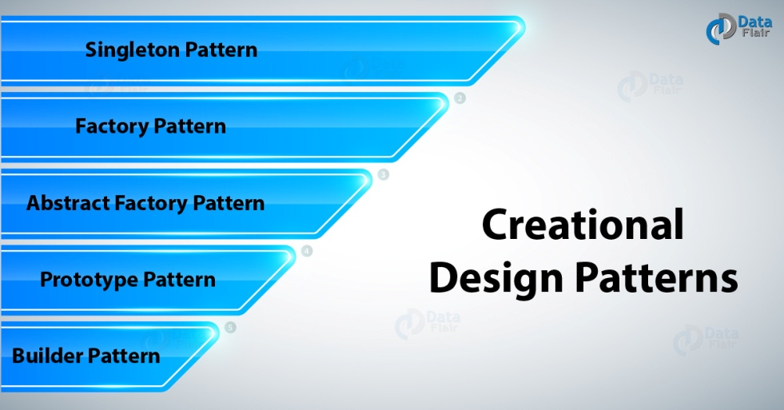
Creational Design Patterns in Java
Creational design patterns in Java give an answer to instantiate an object within the very best approach for specific things.
Creational design patterns are concerned with the way of creating objects. These design patterns are used when a decision must be made at the time of instantiation of a class (i.e. creating an object of a class)..
BSCS (Software Engineering-I) SZABIST-Islamabad

Slide 30
1) Singleton Pattern
Ensure a class has only one instance, and provide a global point of access to it.
Non Software Example:
The office of the President of the United States is a Singleton.
The United States Constitution specifies the means by which a president is elected, limits the term of office, and defines the order of succession.
As a result, there can be at most one active president at any given time.
Regardless of the personal identity of the active president, the title, "The President of the United States" is a global point of access that identifies the person in the office.
BSCS (Software Engineering-I) SZABIST-Islamabad

Slide 31
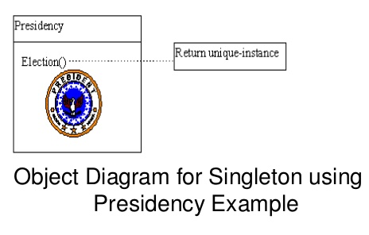
Singleton Pattern
Non Software Example
BSCS (Software Engineering-I) SZABIST-Islamabad

Slide 32
Singleton Pattern
Software Example
In temple run game, the player can play well and set high score
This high score is a single instance of a class
It is a global point of access that identifies highest scored points.
BSCS (Software Engineering-I) SZABIST-Islamabad

Slide 33
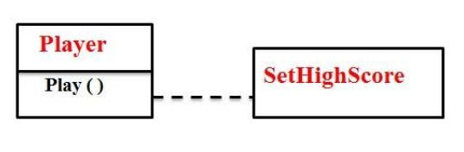
Implementation of Singleton pattern in Temple Run2
BSCS (Software Engineering-I) SZABIST-Islamabad

Slide 34
Structural Patterns in Java
Facade Pattern
Facade pattern employs to help consumer applications to simply act with the system. Suppose we’ve got an application with a set of interfaces to use MySQL/Oracle database and to come up with different types of reports, corresponding to hypertext mark-up language report, PDF report etc. Therefore we’ll have a totally different set of interfaces to figure with differing types of database. Currently, a consumer application will use these interfaces to urge the specified info affiliation and generate reports. However once the complexity will increase or the interface behavior names are confusing, consumer application can realize it troublesome to manage it. Therefore we can apply Facade pattern here and supply a wrapper interface on high of the prevailing interface to assist consumer application. Examine Facade Pattern post for implementation details and a sample program.
Bridge Pattern
Bridge design patterns in Java employs to decouple the interfaces from implementation and concealment the implementation details from the consumer programs. Like Adapter pattern, it’s one amongst the Structural design pattern.
Adapter Pattern
Adapter design patterns in Java, one amongst the structural design pattern and it’s used in order that 2 unrelated interfaces will work along. The object that joins these unrelated interfaces calls as an Adapter. As a true-life example, we can think about a mobile charger as an adapter as a result of mobile battery wants three volts to charge however the normal socket produces either 120V (US) or 240V (India). Therefore the mobile charger works as an adapter between mobile charging socket and also the electrical outlet.
Decorator Pattern
Decorator design pattern employs to change the practicality of an object at runtime. At identical time alternative instances of the identical class won’t be full of this, therefore individual object gets the changed behavior. Decorator design pattern, one amongst the structural design pattern (such as Adapter Pattern, Bridge Pattern, Composite Pattern) and uses abstract classes or interface with the composition to implement.
BSCS (Software Engineering-I) SZABIST-Islamabad

Slide 35
Behavioral Patterns in Java
Observer Pattern
Observer design patterns in Java beneficial to you within the state of an object and needs to urge notified whenever there’s any modification. In observer pattern, the item that watches on the state of another object are known as Observer and also the object that’s being watched inbuilt Subject.
Java provides intrinsically platform for implementing observer pattern through java.util. Observable category and java.util. Observer interface. As a result of the implementation, most of the days we tend to don’t need to finish up extending a category only for implementing Observer pattern as java doesn’t give multiple inheritances in categories
State Pattern
State design patterns in Java employs once an Object changes its behavior supported by its internal state.
If we’ve got to alter the behavior of an object supported its state, we can have a state variable within the Object and use if-else condition block to perform totally different actions supported the state. State pattern employs to produce a scientific and close-coupled thanks to achieving this through Context and State implementations.
Template method Pattern
Template method in Java defines the steps to execute a rule and it will give default implementation that may be common for all or a number of the subclasses
BSCS (Software Engineering-I) SZABIST-Islamabad

Slide 36
Creational Patterns in Java
Singleton Pattern
Singleton design patterns in Java restricts the instantiation of a class and ensures that just one instance of the class exists within the Java virtual machine. It looks to be a really easy design pattern, however, once it involves implementation, it comes with a lot of implementation concerns. The implementation of the Singleton pattern has always been a disputable topic among developers. Examine Singleton design Pattern to be told regarding alternative ways to implement Singleton pattern and execs and cons of every of the method.
Builder Pattern
Builder patterns in Java solves the problem with the sizable amount of ex gratia parameters and inconsistent state by providing how to create the item in small stages and supply a method which will really return the final Object. Examine the Builder Pattern as an example program and a new employed in JDK.
Prototype Pattern
Prototype design patterns in Java employs once the object creation could be an expensive affair and needs a lot of your time and resources and you’ve got the same object already existing. Therefore this pattern provides a mechanism to copy the initial object to a replacement object and so modify it per our wants. This pattern uses Java cloning to copy the object.
Prototype design pattern mandates that the object that you’re copying should provide the super feature. It mustn’t be done by the other class. But whether or not to use a shallow or deep copy of the item properties depends on the necessities and it’s a design call. Examine paradigm Pattern for a sample program.
BSCS (Software Engineering-I) SZABIST-Islamabad

